Slide 1


Title: GROCERY STORE MANAGEMENT SQL PROJECT

Slide 2
About Me:
My name is Katchayani, and I have completed my Bachelor of Computer Applications (BCA). I am interested in becoming a Data Analyst and enjoy working with data to find useful insights. I am passionate about learning new tools and improving my analytical skills.
I have completed my BCA, which helped me build a strong foundation in computers and data-related concepts. I am interested in a Data Analyst role because I like working with data, analyzing patterns, and using data to make better decisions. I am a fresher and currently building my skills through projects and learning tools like SQL and Power BI.
I have completed a SQL-based project on grocery store data analysis, where I analyzed customer orders, product sales, and revenue trends to understand business performance.
LinkedIn :https://www.linkedin.com/in/katchayani-borra-853780301

Slide 3
Project overview:
Project Name: Grocery Management
System Tool: MySQL workbench
Goal: Analyze sales, customers, products

Slide 4
Objectives:
To design and implement a relational database for a grocery store.
To retrieve and manipulate data using SQL queries.
To perform data analysis for business insights such as top customers, best-selling products, and revenue trends.
To practice using joins, aggregations, subqueries, and filtering techniques..

Slide 5
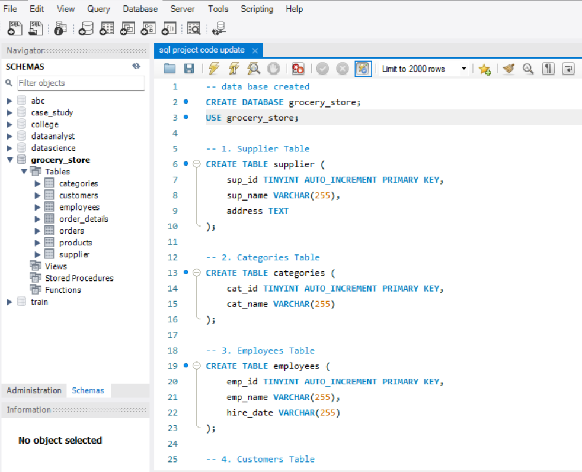
Data base/Tables:
Database : Grocery-store
Tables :
Customers
Orders
Order-Details
Products
Supplier
Employees
Categories

Slide 6

Business Questions:
Who are top customers?
Which products sell more?
What is total sales?
Which employee performs best?
Sales trends over time ?

Slide 7

SQL APPROACH:
HOW I SOLVED:
Used JOINS (combine tables)
Used GROUP BY (aggregation)
Used SUM, AVG, COUNT
Used date functions

Slide 8


ANALYSIS SLIDES:

Slide 9
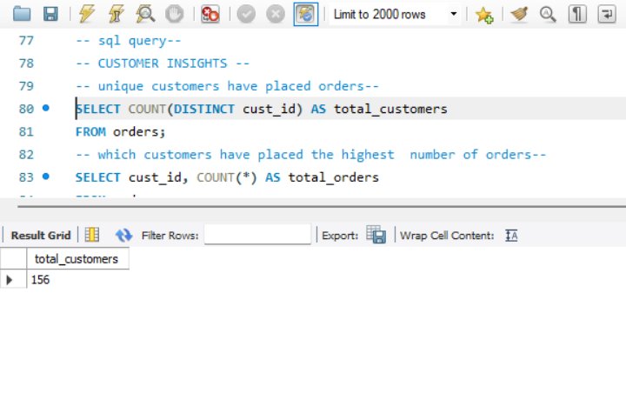
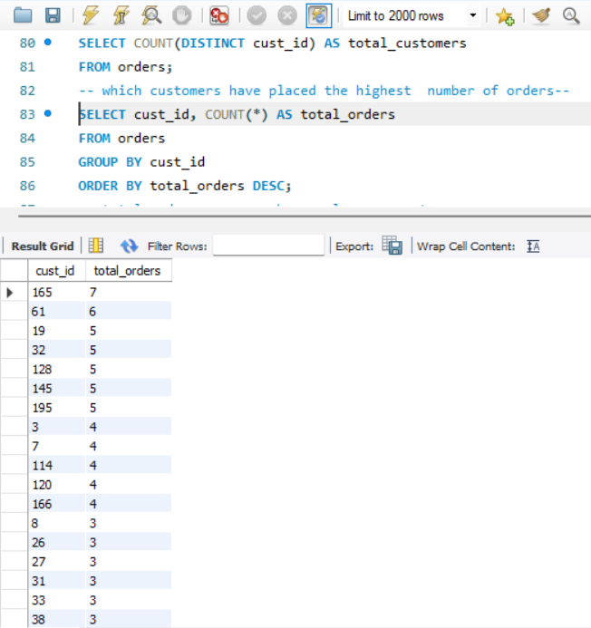
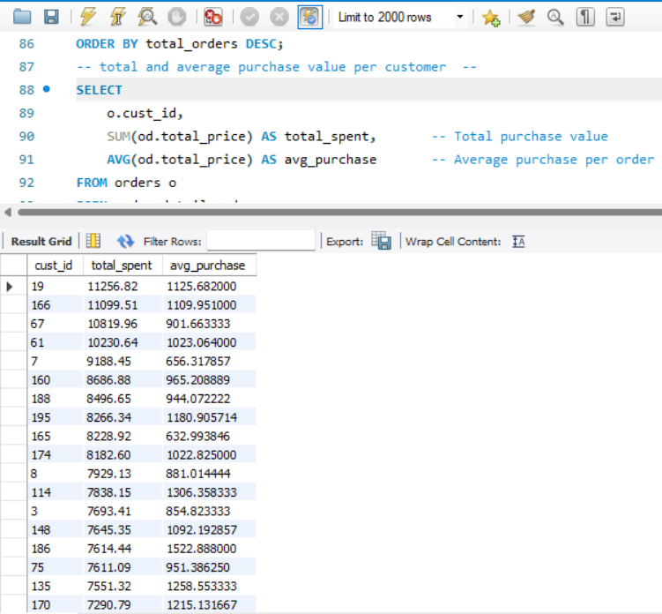
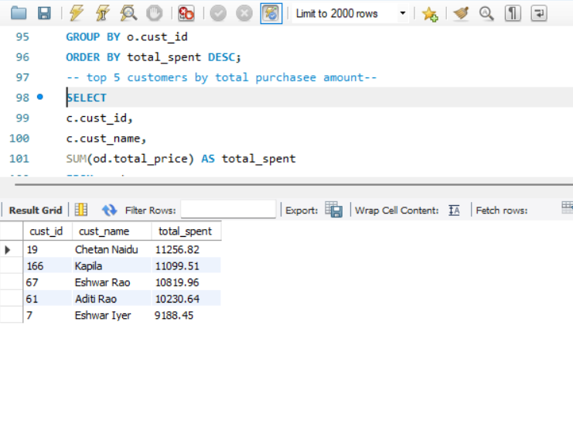
Customer Insights:
Gain an understanding of customer engagement and purchasing behavior
How many unique customers have placed orders?
Which customers have placed the highest number of orders?
What is the total and average purchase value per customer?
Who are the top 5 customers by total purchase amount?

Slide 10
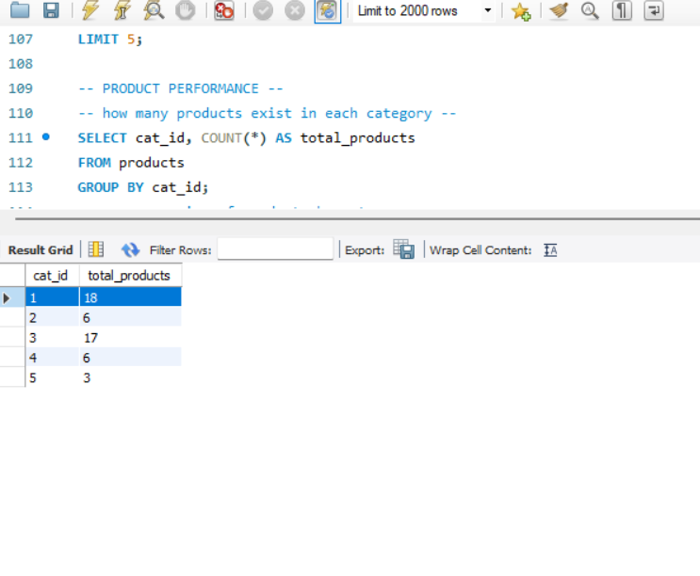
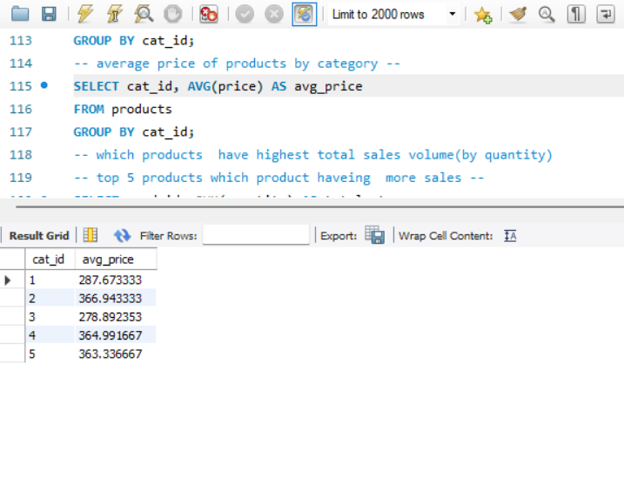
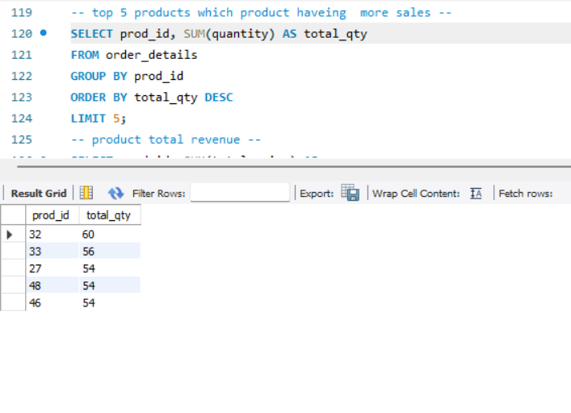
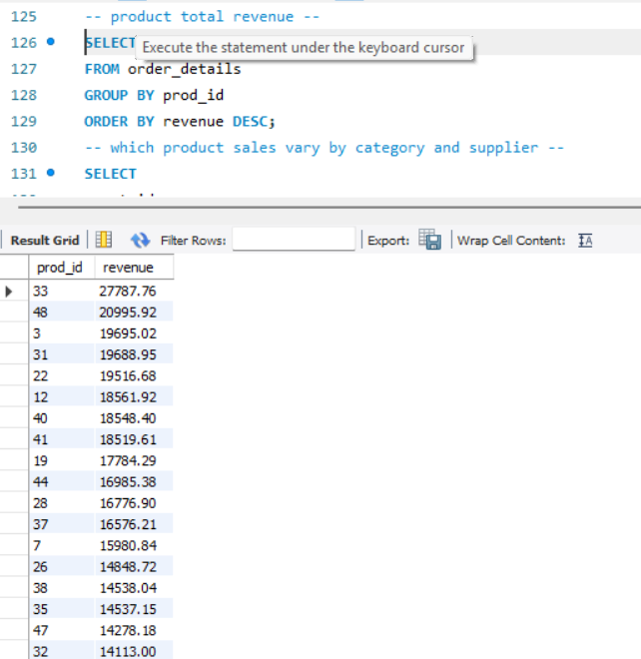
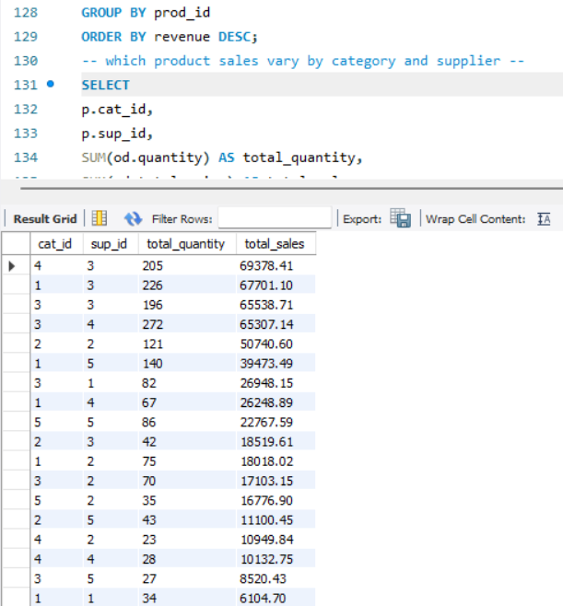
Product Performance:
Evaluate how well products are performing in terms of sales and revenue.
How many products exist in each category?
What is the average price of products by category?
Which products have the highest total sales volume (by quantity)?
What is the total revenue generated by each product?
How do product sales vary by category and supplier?

Slide 11
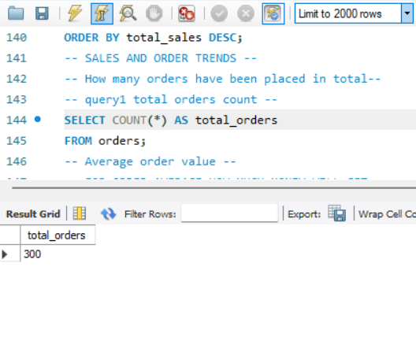
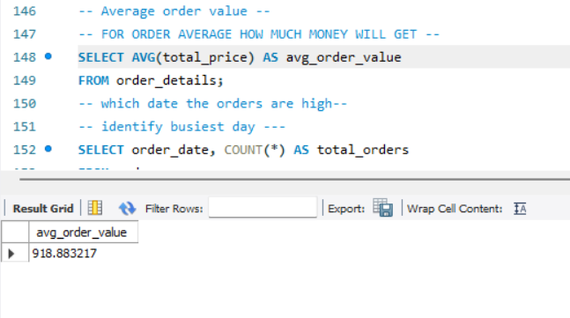
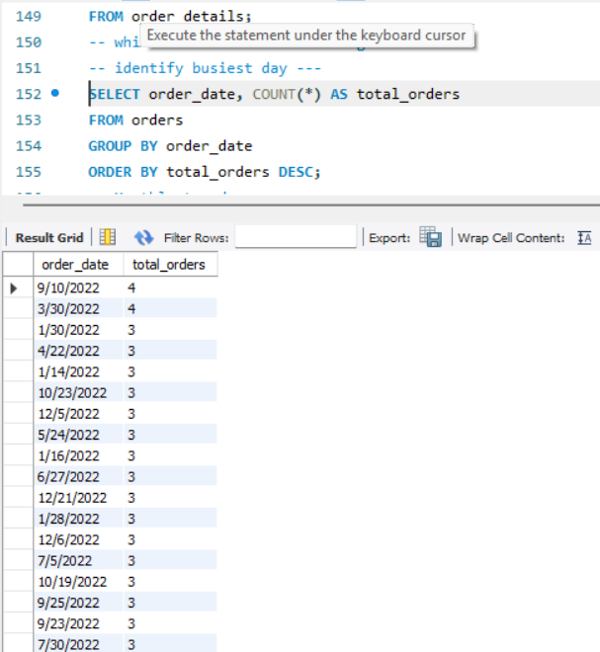
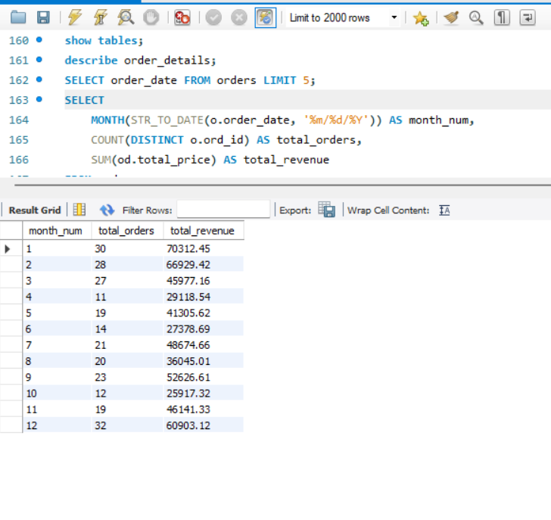
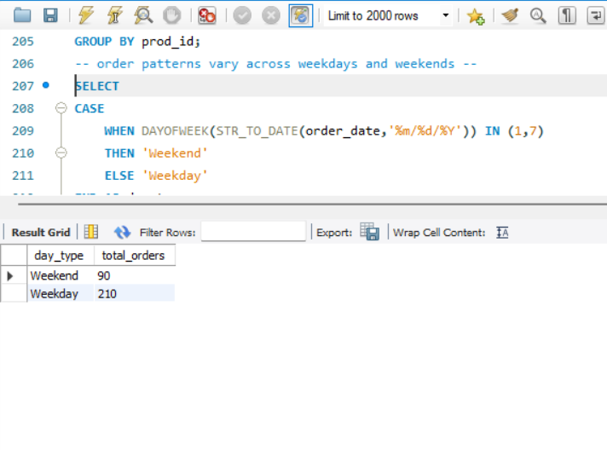
Sales and Order Trends:
Analyze business performance through orders and revenue over time.
How many orders have been placed in total?
What is the average value per order?
On which dates were the most orders placed?
What are the monthly trends in order volume and revenue?
How do order patterns vary across weekdays and weekends?

Slide 12
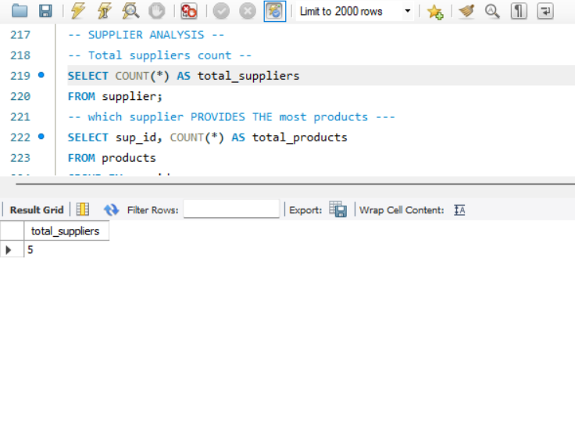
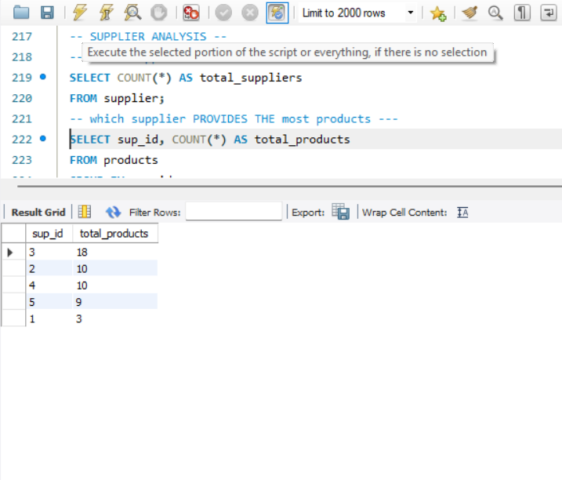
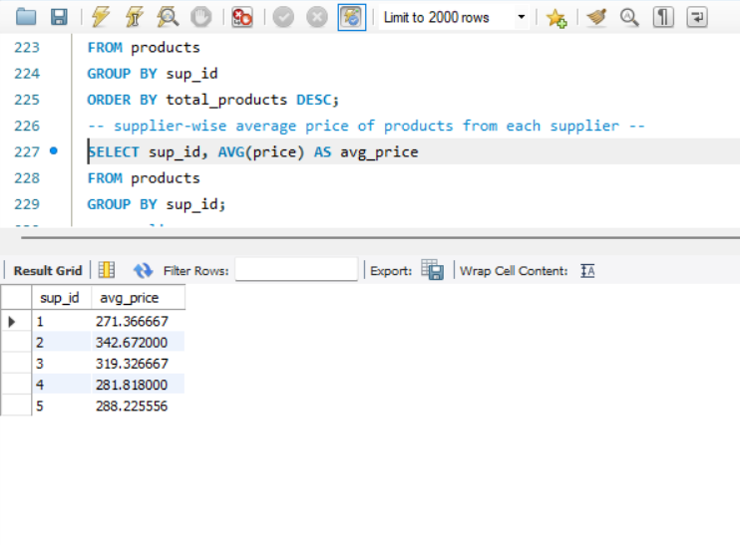
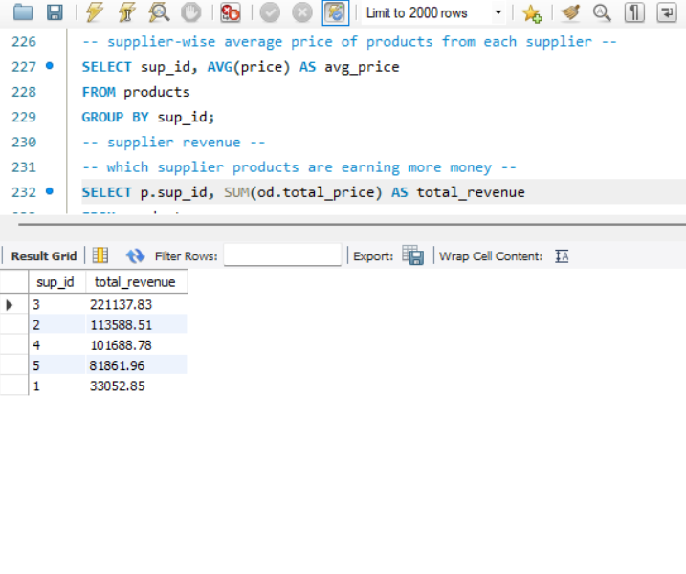
Supplier Contribution:
Identify the most active and profitable suppliers.
How many suppliers are there in the database?
Which supplier provides the most products?
What is the average price of products from each supplier?
Which suppliers contribute the most to total product sales (by revenue)?

Slide 13
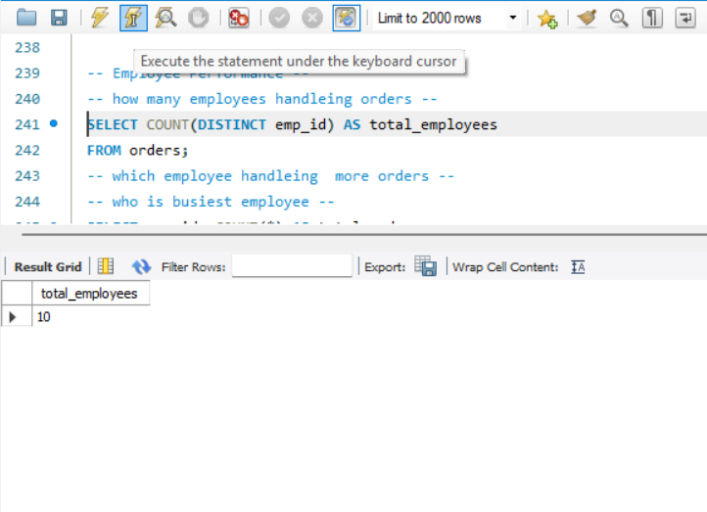
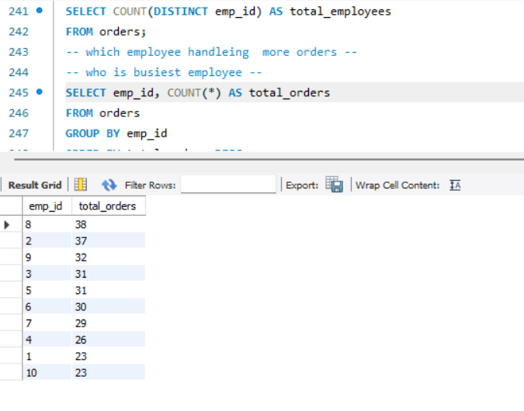
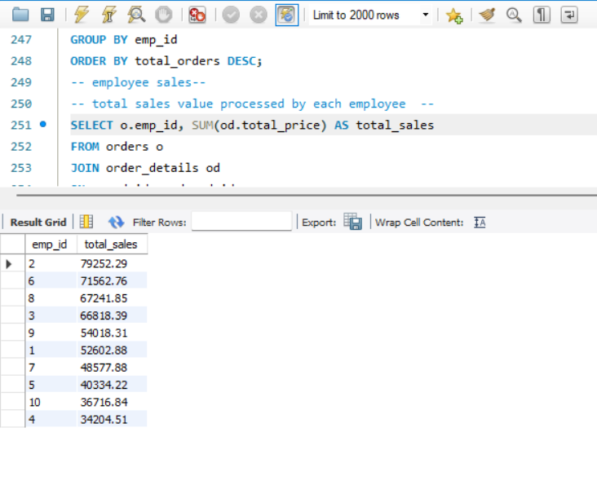
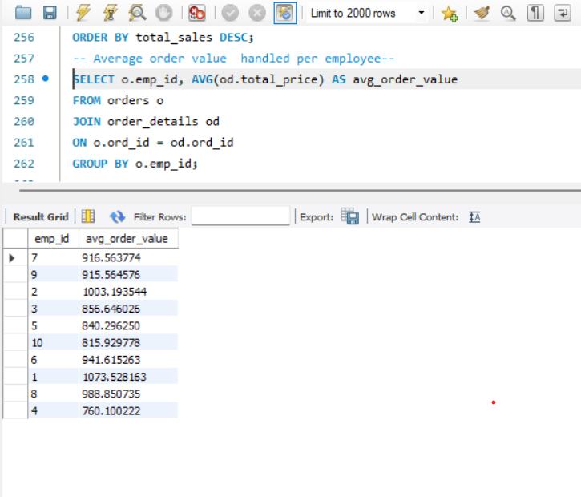
Employee Performance:
Assess how employees are handling and influencing sales.
How many employees have processed orders?
Which employees have handled the most orders?
What is the total sales value processed by each employee?
What is the average order value handled per employee?

Slide 14
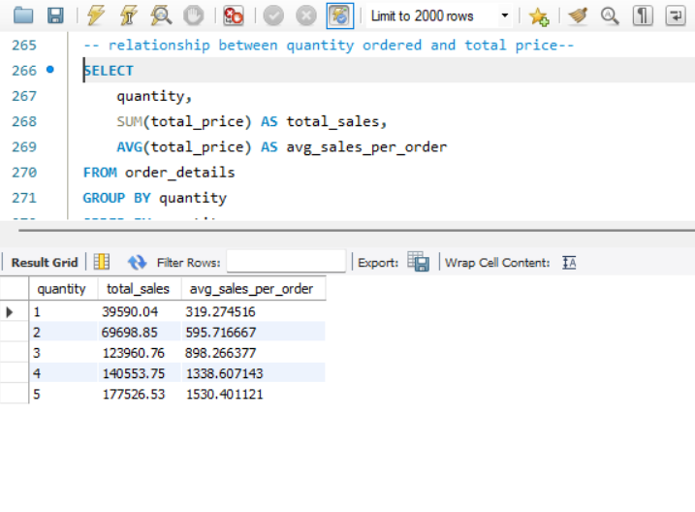
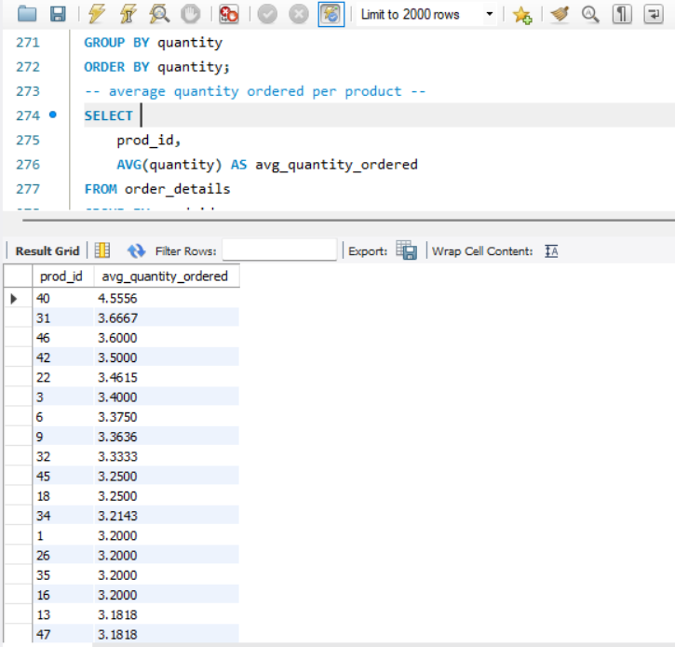
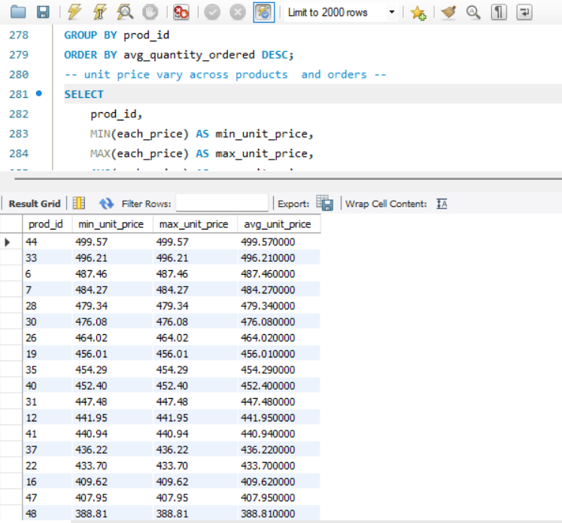
Order details deep drive:
Explore item-level sales patterns and pricing behavior.
What is the relationship between quantity ordered and total price?
What is the average quantity ordered per product?
How does the unit price vary across products and orders?

Slide 15
Conclusion:
This project analyzes customer orders, product sales, and revenue in a grocery store database.
It helps us understand which products sell more and how customers place orders.
The monthly analysis shows how sales and revenue change over time.
By using this data, the business can:
Improve sales in low months
Manage stock in high-demand months
Focus on products that perform well
Overall, this analysis helps the business make better decisions and increase profit.

Slide 16
Experiences & Challenges:
Understanding table relationships and applying correct joins.
Ensuring data consistency with foreign key constraints.
Handling aggregation across joined tables.
Extracting time-based trends from date data (especially if in VARCHAR format).

Slide 17


Slide 18

THANK YOU

Slide 19
Challenges:
Understanding joins
Handling aggregations
Working with date format

